Slide 1


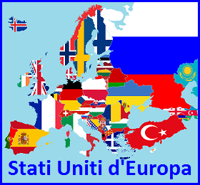


PROGRAMME ERASMUS + PROJECT- ,,ON THE MOVE IN EUROPE –
TOWARDS A DEMOCRATIC MULTICULTURAL EUROPE”
NR. 2016-1-DE03-KA219-022832_2
.
A BRIEF HISTORICAL PERSPECTIVE ON HUMAN MIGRATIONS IN ROMANIA
National Pedagogical College
“C. Bratescu”
Constanta, Romania
Igualada, Spain,
March 2017

Slide 2
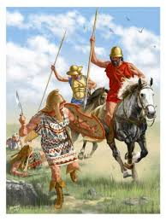
The history that has shaped Romania
-the first tribes settled
Romania has been inhabited since the Paleolithic Age, as evidenced by carved stone tools unearthed there.
3,000 B.C.
Thracian tribes of Indo-European origin, who migrated from Asia, occupied the actual territory of Romania.
2,000 B.C. A distinctive Thracian sub-group emerged in what is now Romania.The Greeks called these people Getae, but to the Romans they were Dacians; Herodotus called them "the fairest and most courageous of men“, because they believed in the immortality of the soul and were not afraid to die.

Slide 3

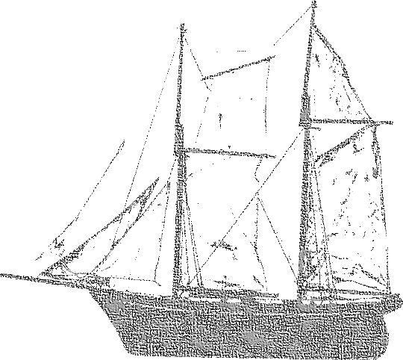
Waves of Immigration
Greeks arrived and settled
colonies on the western coast of Black Sea 700 B.C.
Histria or Istros - the first urban settlement (“polis”) on Romanian territory; situated near the mouths of the Danube, the city went through Roman rule, until the invasions in 7 th century when was abandoned.
Tomis (or Tomi), the actual city of Constanta – was the second Greek colony on the Black Sea shore, founded for commercial exchanges with the local Getic populations; this is the city we come from.
Callatis – the actual city of Mangalia.

Slide 4
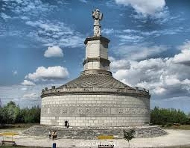
Waves of Immigration
Romans colonize Dacia (modern-today Romania) 106 A.D
After Dacian civilization reaches its peak, Romans conquer and colonize Dacia with an impresive number of colonists originarly from all the Empire and even Westrern Asia.
So, Dacia becomes a province of the Roman Empire (106-274 A.D).
Dacians gradually adopt numerous elements of the conquerors' language.
Tropaeum Traiani (monument in the honor of Emperor Trajan-in Adamclisi (55 km from Constanta, our city)

Slide 5
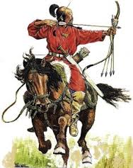


Waves of Immigration
-The migrating peoples-
Nomadic tribes from Asia and Europe (Goths, Visigoths, Huns, Slavs) invade Dacia
4th to 9th Centuries
The Goths mixed with the local people until 4th century, when a nomadic people, the Huns, arrived.
The Gepids and the Avars and their Slavic subjects ruled Transylvania until 8th century.
The Pechenegs, the Cumans and Uzes were also mentioned by historic chronicles, until the founding of the Romanian principalities around 1300.
Different migrating peoples lived alongside the local populations,such as: the Gothic Empire,from 271-378, the Hunnish Empire- until 435,the Avar Empire and Slavs during the 6th century.

Slide 6

Waves of Immigration
Colonization of the Romanian territory
896 — late 1100 s
Magyars (Hungarians) invade regions in western and central present-day Romania (Crisana, Banat and Transylvania)
12th century- Saxon (German) settlers, brought by the king of Hungary, to consolidate his power, begin to establish several towns in Transylvania.
Szeklers people- descendants from Attila’s Huns- were also brought to eastern and southeastern Transylvania as border guards.
Between 1000- 1100 -Gypsies entered Romanian territory.

Slide 7
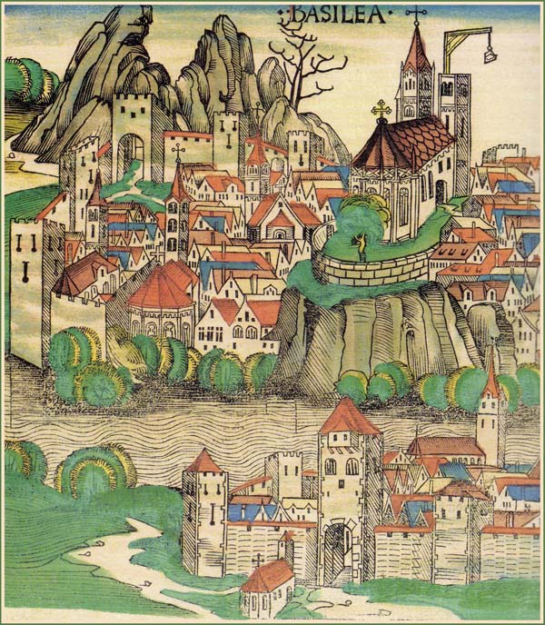
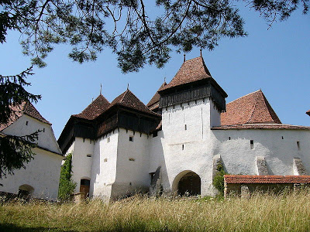
German and Hungarian ethnics brought an important contribution to settlement architecture and landscape in
Transylvania (the central part of Romania)
Saxon settlement in Transylvania (Romania)
A church built in the 12th century by Szekely (Szeklers, Hungarian ethnics) colonists- Transylvania

Slide 8

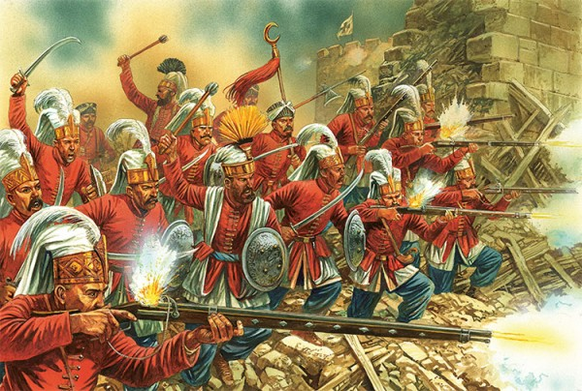
Waves of Immigration
Ottoman Empire expansion
and Romanian Muslims
The three Romanian provinces of Wallachia, Moldova and Transylvania have been under the suzerainty of the Turkish Ottoman Empire for couple of centuries, but they were able to retain their autonomy by paying tribute to the Turks.
Northern Dobruja, a region on the Black Sea coast which was part of the Ottoman Empire for almost five centuries (1420-1878) allowed Turkish traders to settle here, followed by the
Exod to Dobruja:
Crimean Tatars took refuge in Dobruja 1783
Circassians (200,000), refugees from the Caucasian War, resettled in the Dobruja and northern Bulgaria by the Ottomans

Slide 9

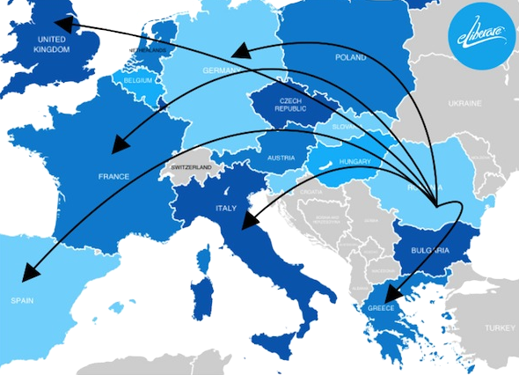
Actual migrations in Romania
(migrant flow in the last 25 years )
Emigration
Economic migrants
The most important reason why more than 1,5 milion Romanians choose to migrate to another country is the economic one.
Globalisation has increased the demand for workers from other countries in order to sustain national economies.
The economic migrants have been oriented towards Spain, Italy, Germany, France, U.K.

Slide 10

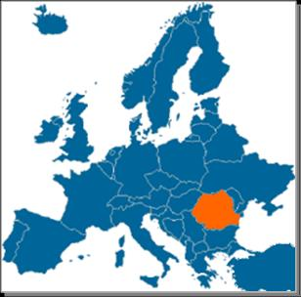

Actual migrations in Romania
Immigration to Romania
Romania, though not a very popular destination for immigrants, has recently experienced a growing wave of immigration, mostly from the
Republic of Moldova
Turkey
China
Africa
the Middle East
the former Soviet Union
There were 198,839 immigrants living in Romania, of which 13,000 were refugees in 2015

Slide 11


Romanian Team
Thank you for your attention!
Authors:
Prof.Dr. Popescu Polixenia
Andoni Iliuta-Laurentiu
Cristurean Cezar Vasile

